Slide 1


Project 1
Transshipment Problem
Group 6:
Qianran Ma (7798937244) Presenter
Wanning Li (5898212888)
Yanan Zhou (4366462176)
Yuxuan Cheng (1278632602)
March 10, 2022

Slide 2


Contents
1
Background
2
Models
3
Creative Ideas
4
Further Attempts

Slide 3


1
Background

Slide 4
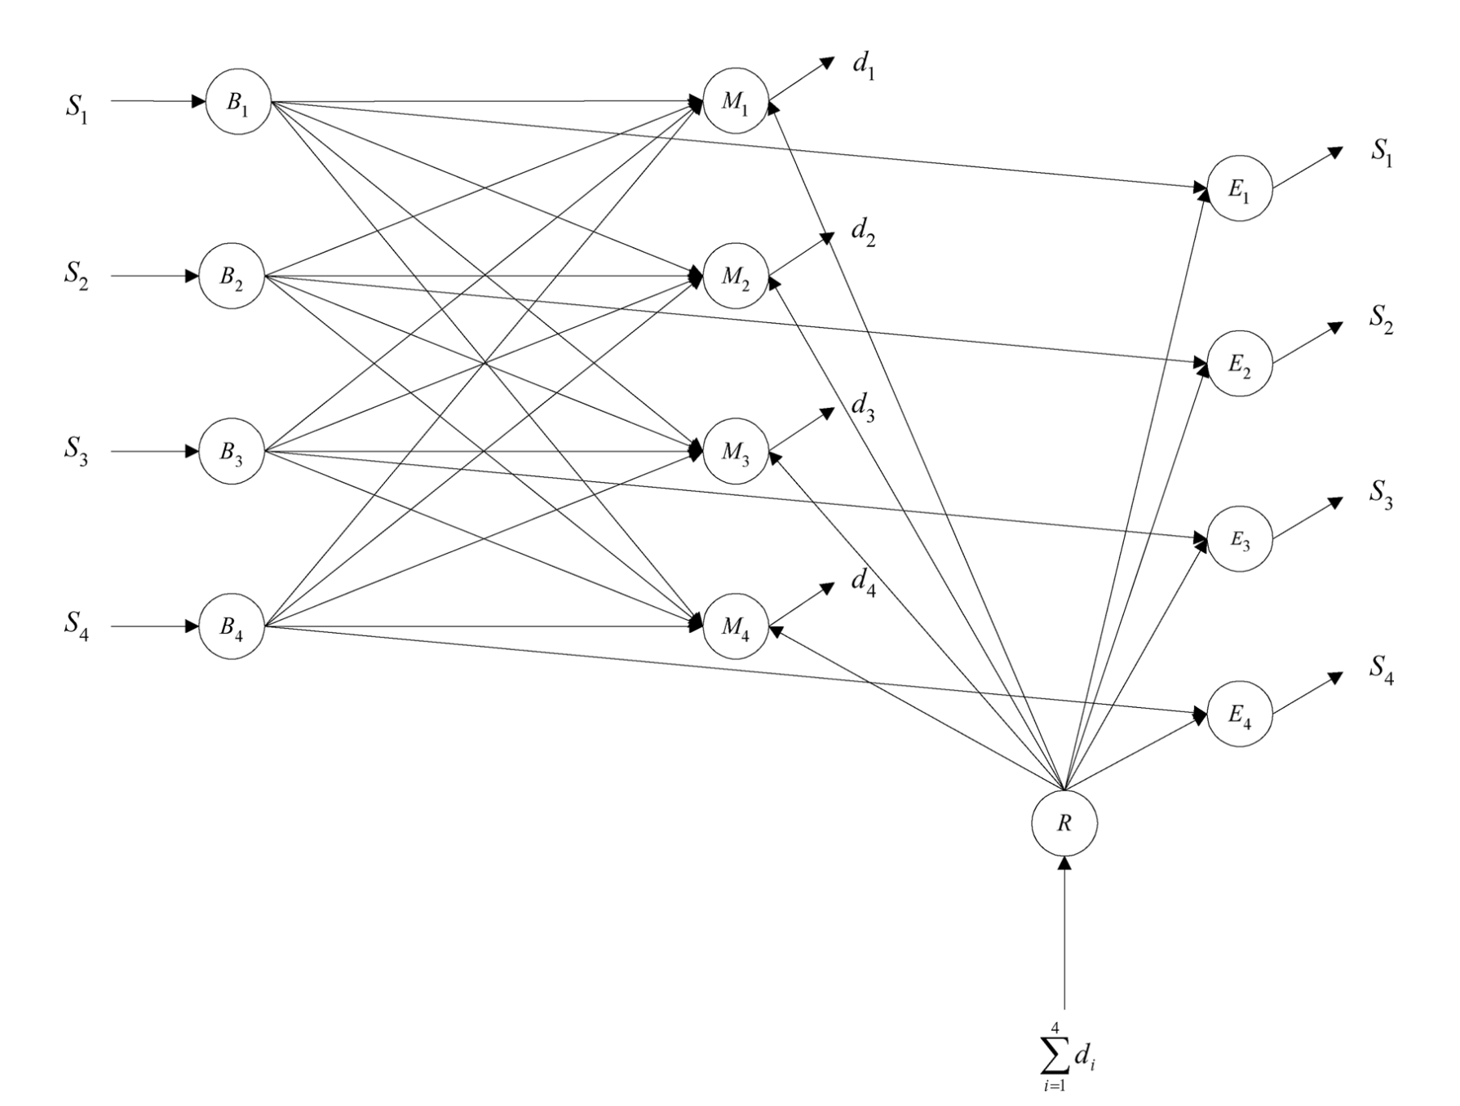
Background ---- Transshipment model (Given S)
S
Stage 1: Order-up-to S

Slide 5
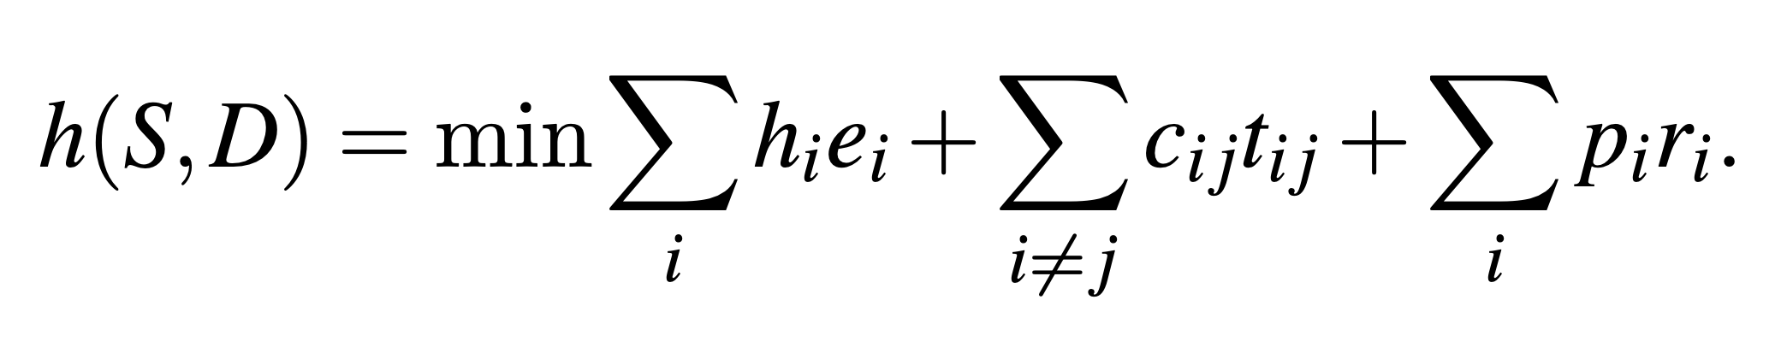
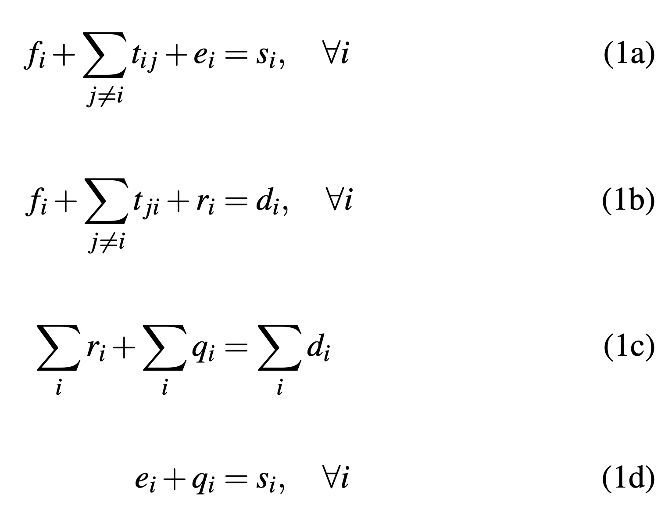
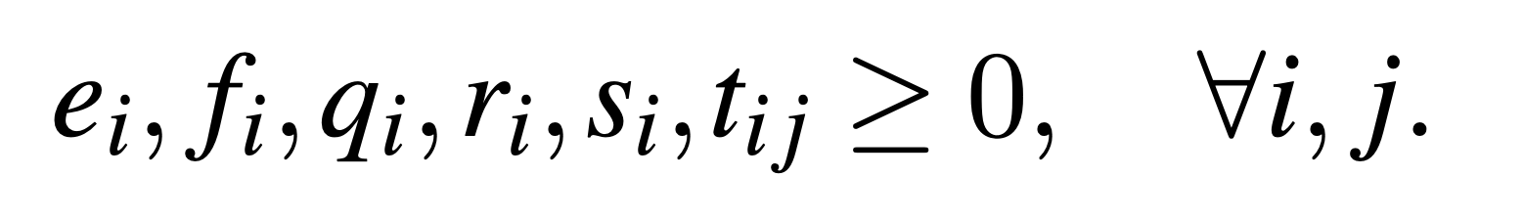
Background ---- Transshipment model (Given S)
Stage 2: Transshipment decision
transshipment cost
f : stock for demand
S
penalty cost
r : backorder
t : transshipment

Slide 6
Background ---- Transshipment model (Given S)
Stage 2: Transshipment decision
holding cost
f
e : ending inventory
S
t
r
q : inventory increased through replenishment

Slide 7
2
Models
All-in-One
Stochastic Approximation
Stochastic Decomposition

Slide 8
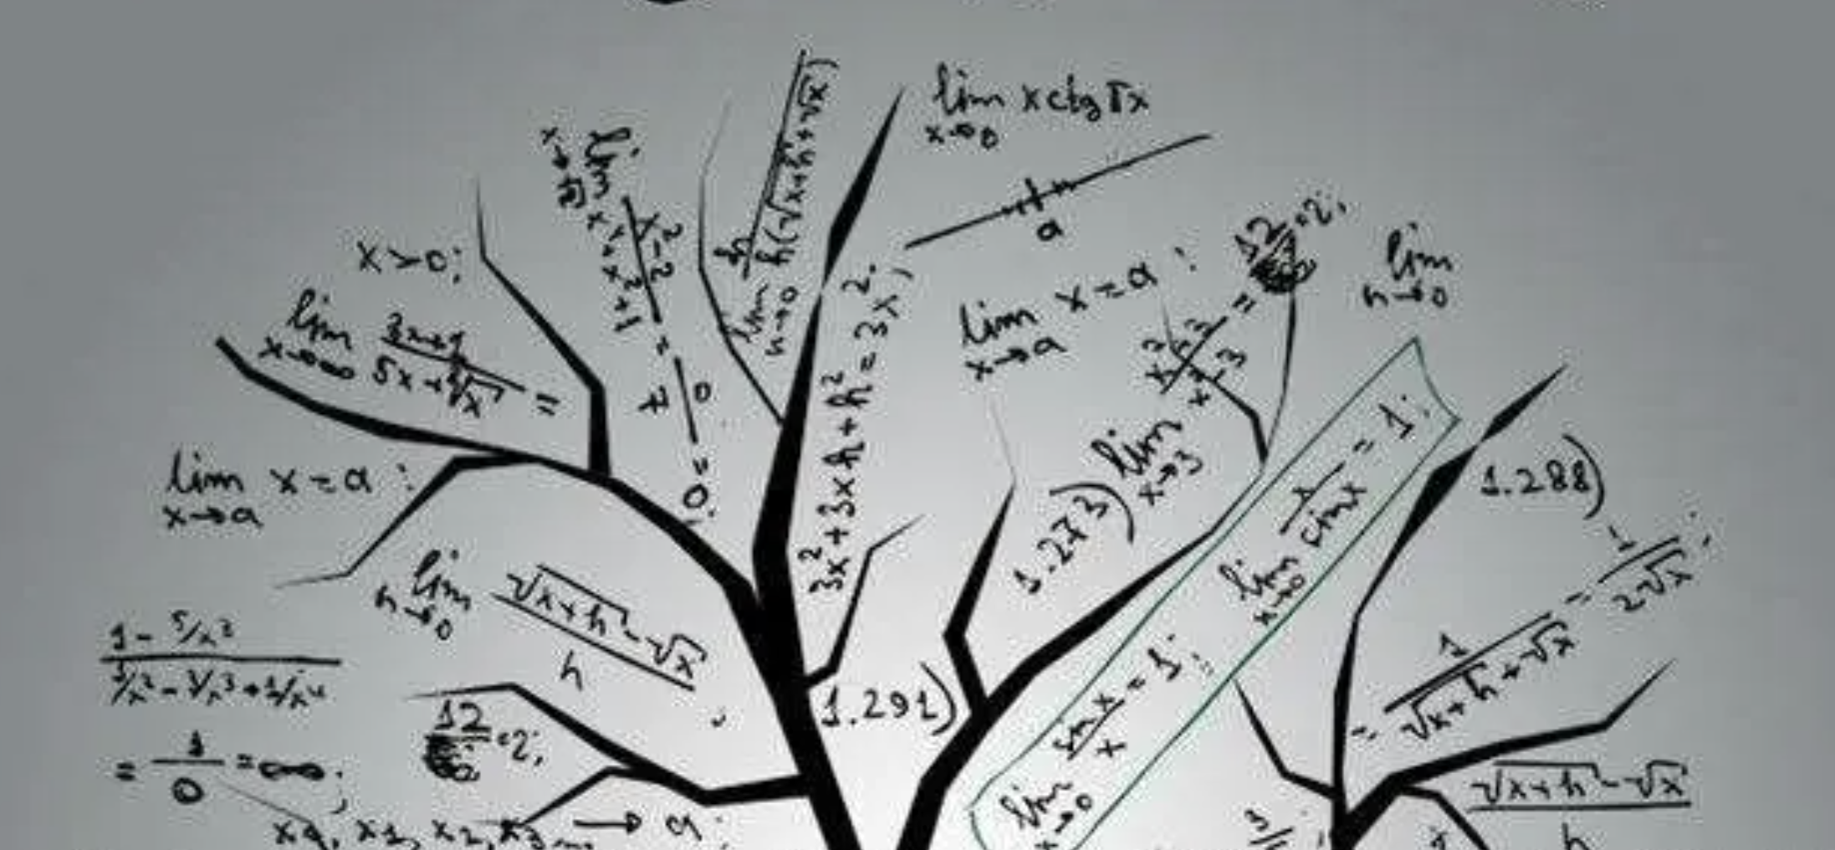
2.Models
1
All-in-One
2
Stochastic Approximation
3
Stochastic Decompostion

Slide 9
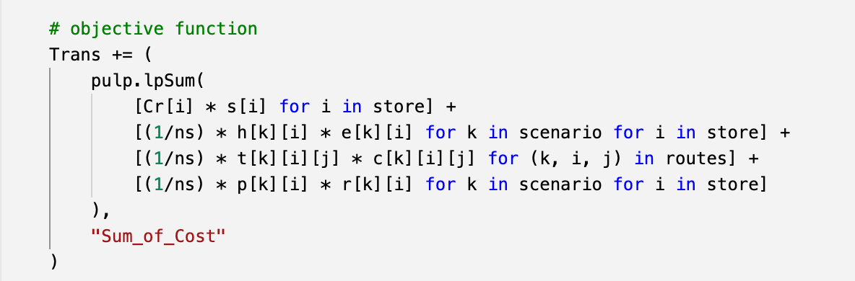
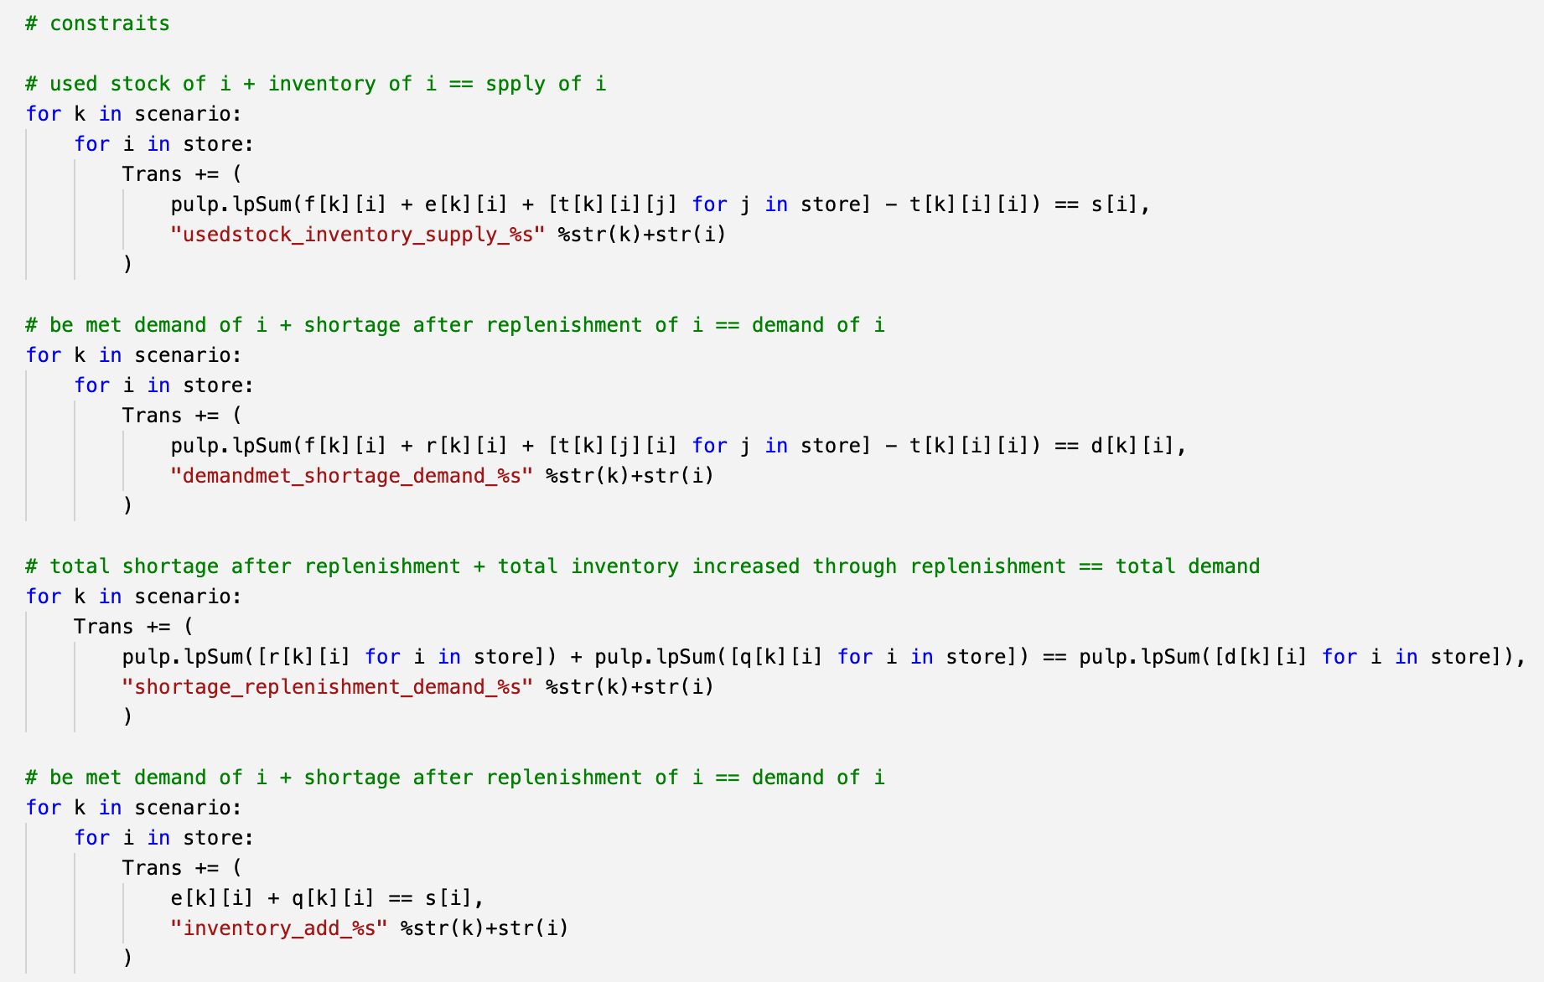
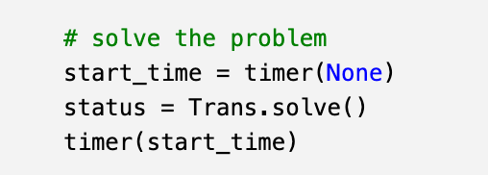
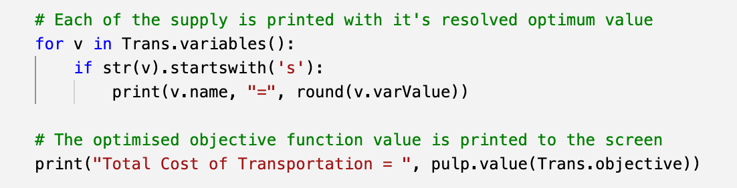
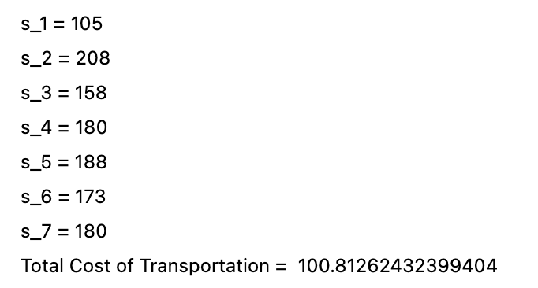
All-in-One (Uniform Distributed Scenarios )
# set up the optimization problem
Trans = pulp.LpProblem("Transshipment_Problem", pulp.LpMinimize)
# the number of stores
store = [1, 2, 3, 4, 5, 6, 7]
n = len(store)
# the number of scenarios
scenario = list(range(1, 3**7 + 1))
ns = len(scenario)
# 3^7 scenarios
# stochastic parameter ---> demand of each store
mu = pulp.makeDict([store], [100, 200, 150, 170, 180, 170, 170], 0)
sigma = pulp.makeDict([store], [20, 50, 30, 50, 40, 30, 50], 0)
d0 = [stats.norm.ppf(q = [0.25, 0.5, 0.75], loc = mu[i], scale = sigma[i]).tolist() for i in range(1,8)]
d1 = list(itertools.product(d0[0], d0[1], d0[2], d0[3], d0[4], d0[5], d0[6]))
d = [list(i) for i in d1]
d = pulp.makeDict([scenario, store], d, 0)
# set up fixed parameters
# 7 stores replenishment cost
Cr = [0, 0, 0, 0, 0, 0, 0]
Cr = pulp.makeDict([store], Cr, 0)
# 7 stores holding inventory cost
h = [[1, 1, 1, 1, 1, 1, 1]] * ns
h = pulp.makeDict([scenario, store], h, 0)
# transshipment routes from i to j
routes = [(k, i, j) for k in scenario for i in store for j in store]
# transshipment cost from retailer i to j
c = np.ones((ns, n, n)) * 0.5
for i in range(ns):
np.fill_diagonal(c[i], 0)
c = c.tolist()
c = pulp.makeDict([scenario, store, store], c, 0)
# 7 stores penalty for shortage after replenishment
p = [[4, 4, 4, 4, 4, 4, 4]] * ns
p = pulp.makeDict([scenario, store], p, 0)
# set up variables
# 7 stores supply
s = pulp.LpVariable.dicts("s", store, 0, None, pulp.LpInteger)
# 7 stores ending inventory
e = pulp.LpVariable.dicts("e", (scenario, store), 0, None, pulp.LpInteger)
# 7 stores shortage after transshipment
r = pulp.LpVariable.dicts("r", (scenario, store), 0, None, pulp.LpInteger)
# 7 stores shortage met by transshipment ---> stock at i used to meet demand of j
t = pulp.LpVariable.dicts("t", (scenario, store, store), 0, None, pulp.LpInteger)
# 7 stores shortage met by itself ---> stock at i used to meet demand of i
f = pulp.LpVariable.dicts("f", (scenario, store), 0, None, pulp.LpInteger)
# inventory at store i increased through replenishment
q = pulp.LpVariable.dicts("q", (scenario, store), 0, None, pulp.LpInteger)
objective function
3^7 scenarios & demands
constraints
fixed cost parameters
optimal solution
&
optimal value
variables
* 3 demands of each store: [0.25, 0.5, 0.75]

Slide 10
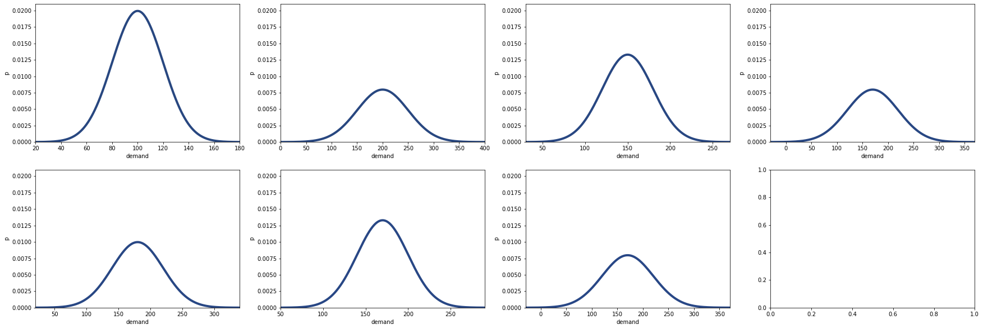
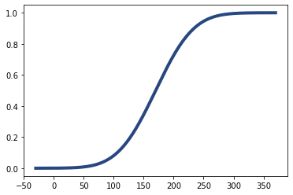
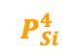
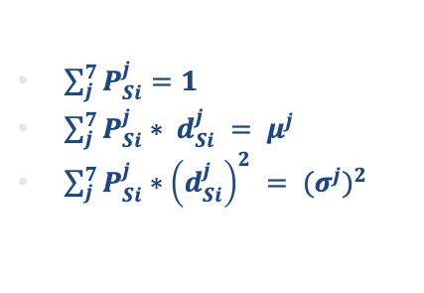
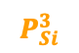
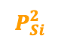
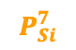
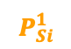
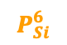
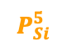
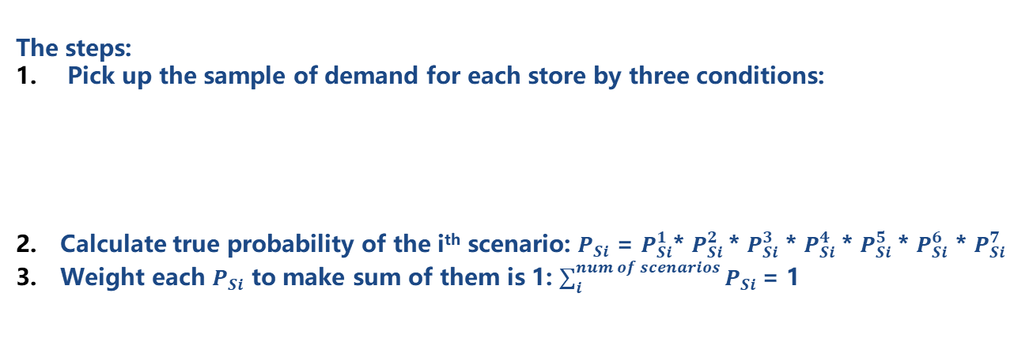
All-in-One
Original Algorithm
Optimization Ideas
$$P_{Si}^{1}$$
$$P_{Si}^{2}$$
$$P_{Si}^{3}$$
$$P_{Si}^{4}$$
$$P_{Si}^{5}$$
$$P_{Si}^{6}$$
$$P_{Si}^{7}$$
The steps:
Pick up the sample of demand for each store by three conditions:
Calculate true probability of the i^{th} scenario: $P_{Si}$ = $P_{Si}^{1}$* $P_{Si}^{2}$ * $P_{Si}^{3}$ * $P_{Si}^{4}$* $P_{Si}^{5}$* $P_{Si}^{6}$ * $P_{Si}^{7}$
Weight each $P_{Si}$ to make sum of them is 1: $\sum_{i}^{num of scenarios}{P_{Si}}$= 1
We assume all the scenarios are uniformly distributed, and they have the same probability to appear.
$\sum_{j}^{7}{P_{Si}^{j}}=1$
${\sum_{j}^{7}{P_{Si}^{j}∗ d_{Si}^{j}} = μ}^{j}$
$\sum_{j}^{7}{P_{Si}^{j}∗{\left(d_{Si}^{j}\right)}^{2}} = {{(σ}^{j})}^{2}$

Slide 11
2.Models
1
All-in-One
2
Stochastic Approximation
3
Stochastic Decompostion

Slide 12
Stochastic Approximation
Algorithm:
Set initial S (mean of demand distribution), K, U
loop1:
dTC = 0
loop2:
Generate demands
Solve transshipment dual model
Accumulate dTC = B+E
Until U
Calculate average dTC / U
Update S = Projection(S - step_wise (dTC / U))
Until K

Slide 13
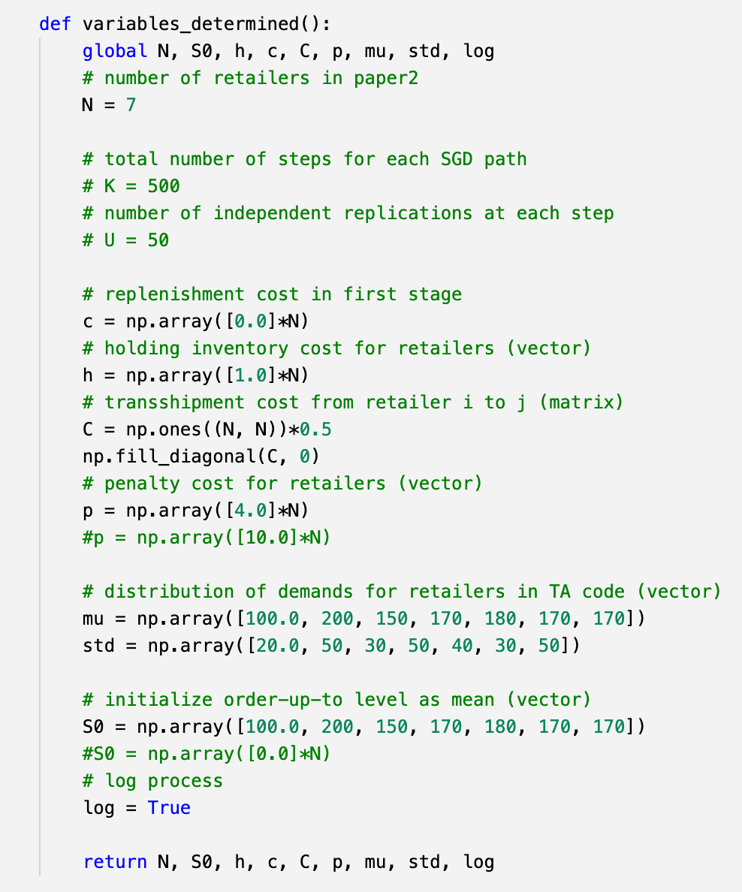
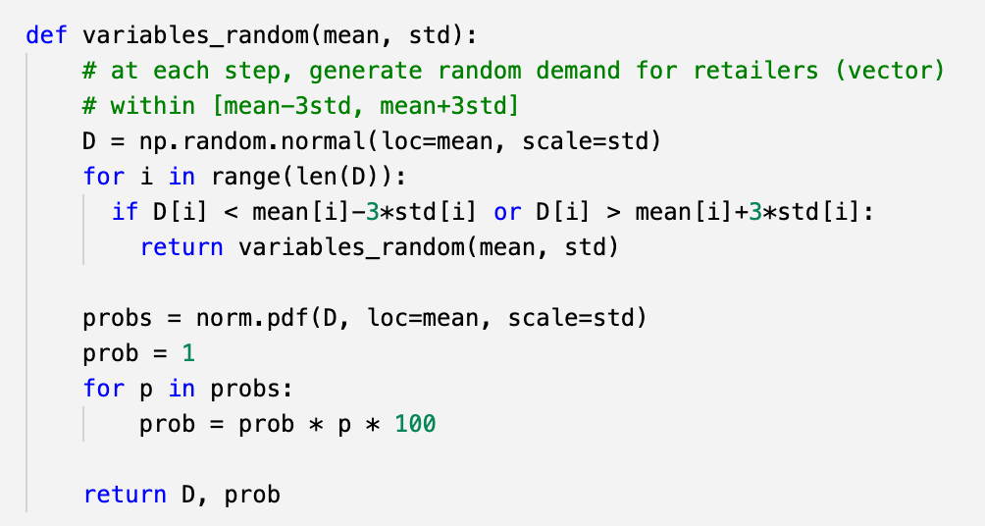
Stochastic Approximation --- Define Variables
Each demand within 3 deviation bound
return the probability of each set to calculate the expected value later on

Slide 14
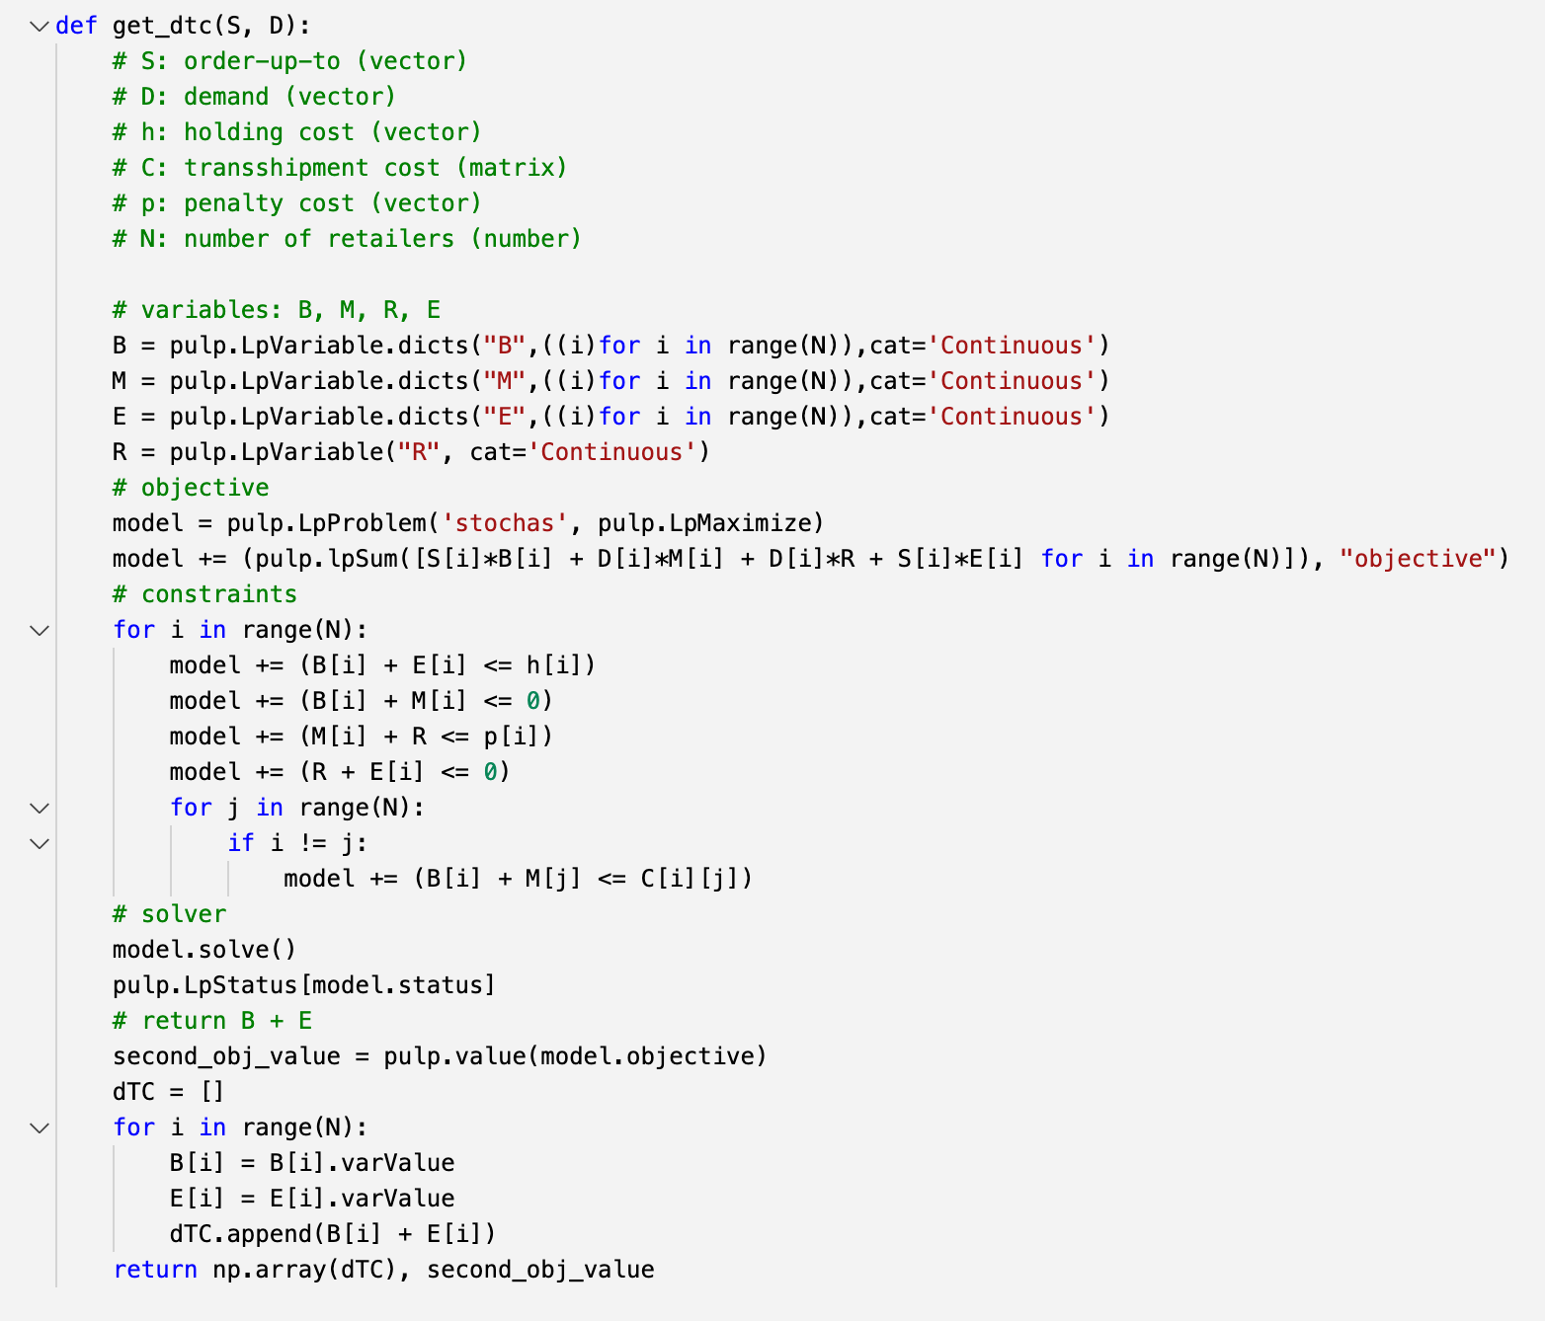
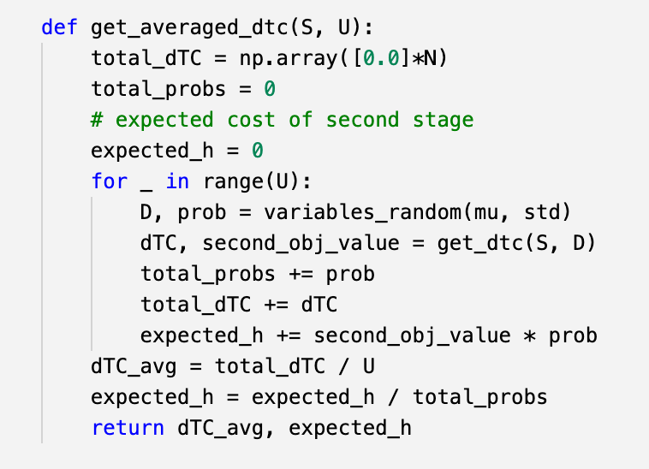

Stochastic Approximation --- Solve Dual Problem

Slide 15

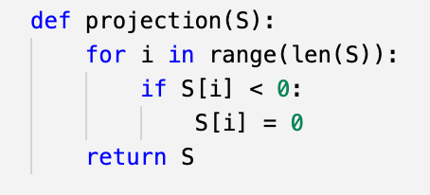
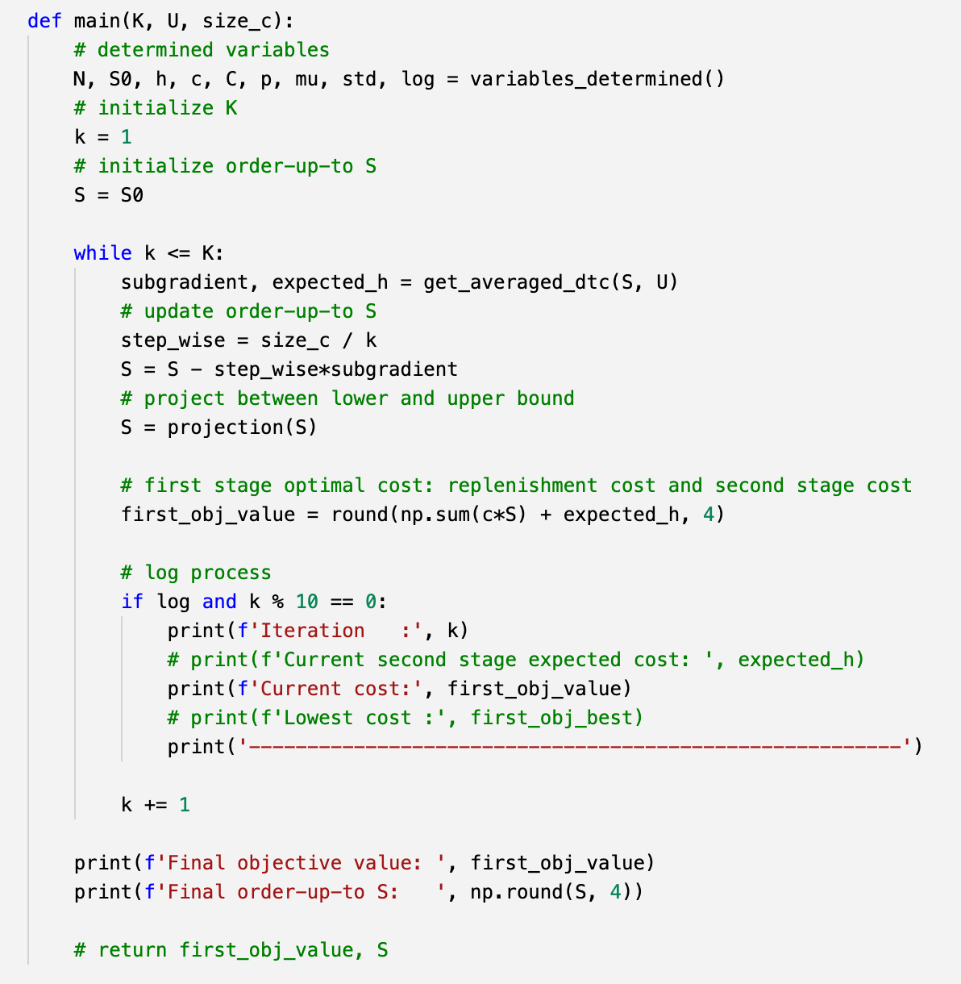
Stochastic Approximation --- Update S

Slide 16
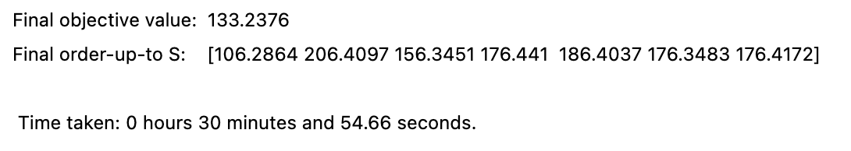
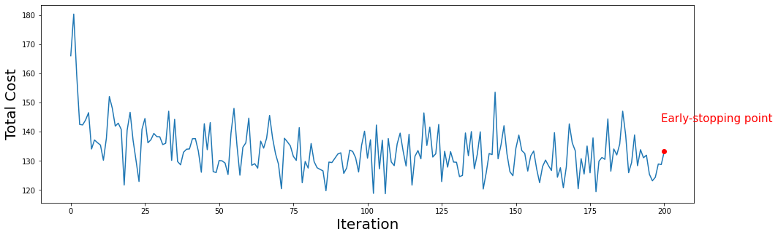
Stochastic Approximation --- Result

Slide 17
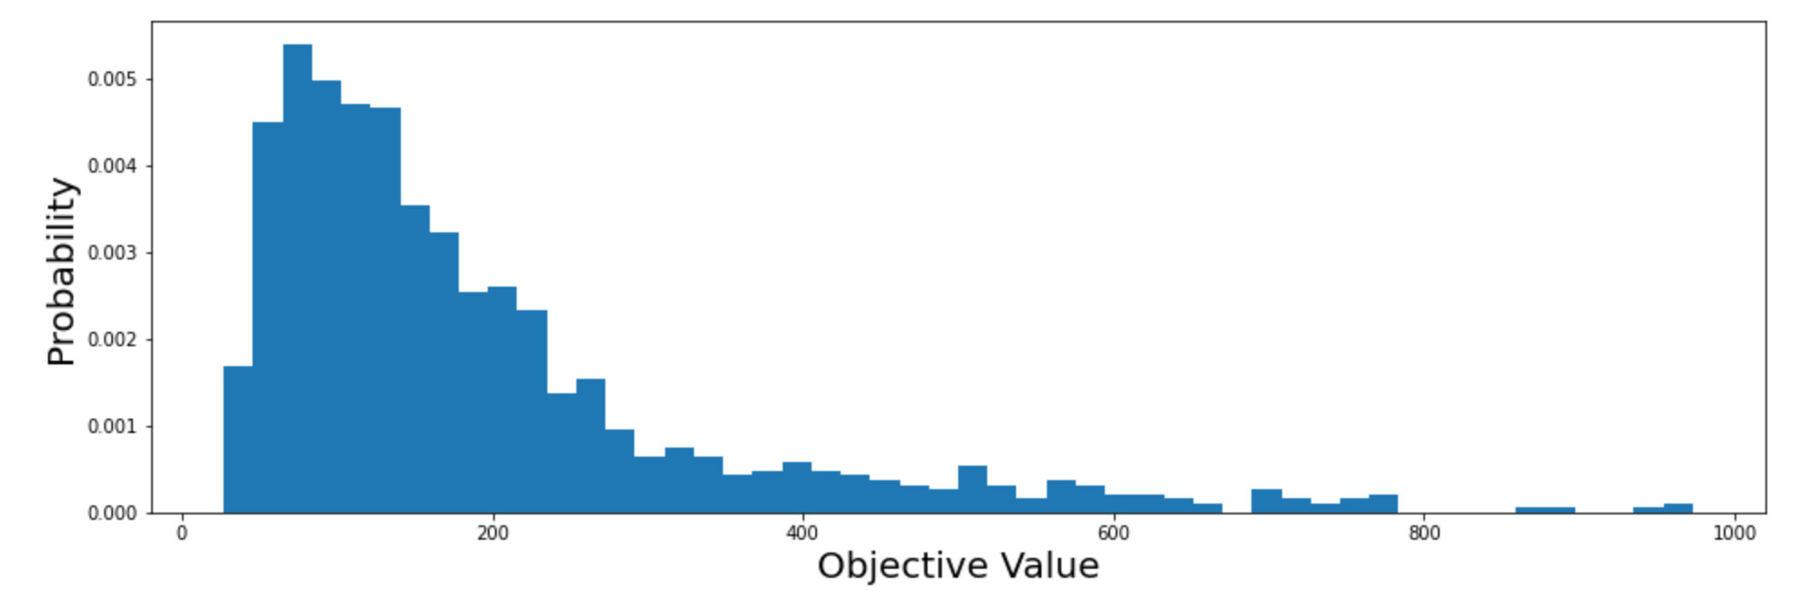
Stochastic Approximation --- Result
Min: 27.0524
Max: 973.4
Median: 142.8638
Mean: 193.04
95% Confidence Interval: [183.7315 203.0226]

Slide 18
2.Models
1
All-in-One
2
Stochastic Approximation
3
Stochastic Decompostion

Slide 19
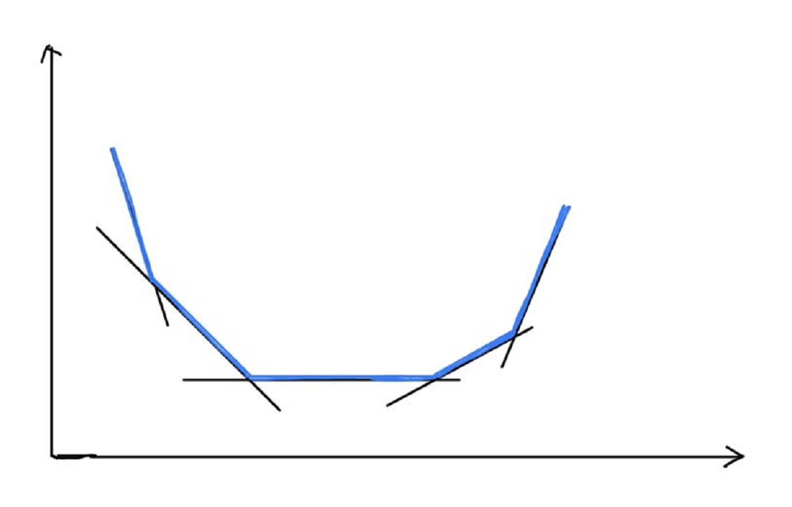



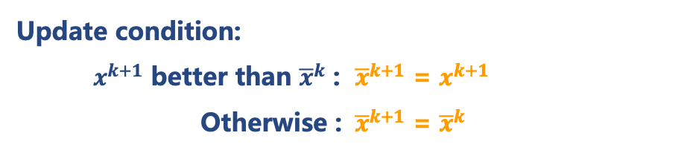
Stochastic Decomposition --- Model
Combining many “cuts” together to compose the shape of the transshipment model approximately.
Master program:
$min f_{k}\left(x\right)$
$s.t. Ax≤b$
${(M}^{k}$)
Candidate solution:
$x^{k+1 }$ --- the solution to ${(M}^{k})$
Incumbent solution:
${\overline{x}}^{k}$ --- a solution that is potentially the best point generated by the algorithm during the first k iteration
Update condition:
$x^{k+1}$ better than ${\overline{x}}^{k}$ : ${\overline{x}}^{k+1}$ = $x^{k+1}$
Otherwise : ${\overline{x}}^{k+1}$ = ${\overline{x}}^{k}$
$f_{k}\left(x\right)$ is also updated in each iteration.

Slide 20
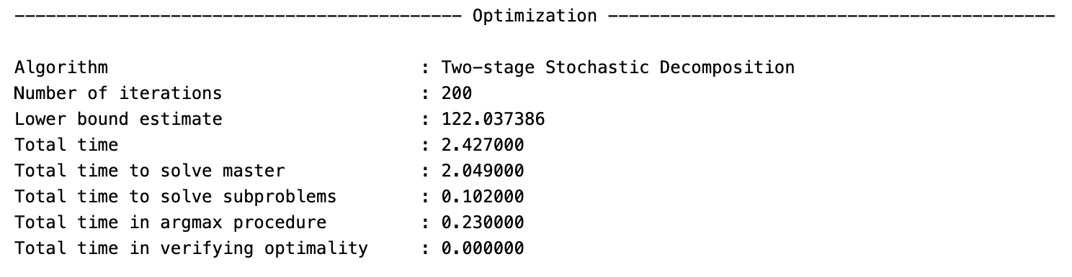
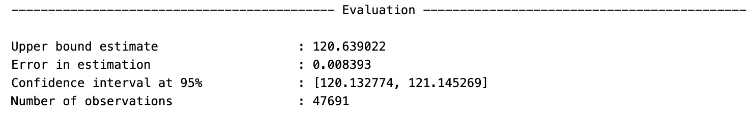
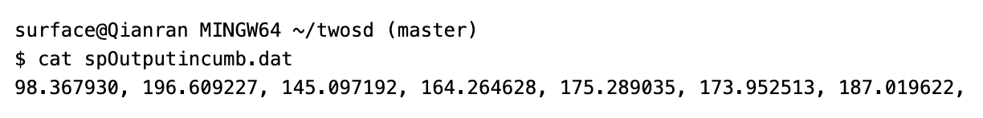
Stochastic Decomposition --- Result

Slide 21
3
Creative Ideas
Improvements on the function
Improvements on SA model

Slide 22

3.Creative Ideas
1
Improvements on the function
2
Improvements on the SA model

Slide 23
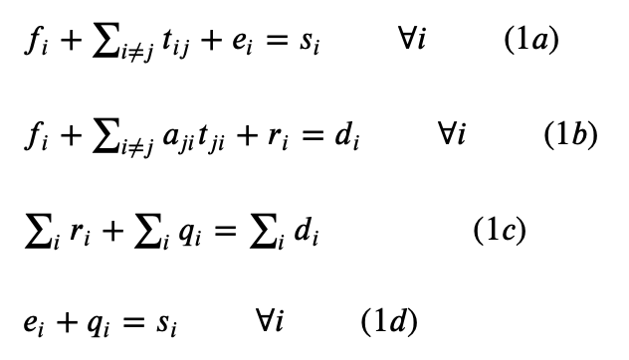
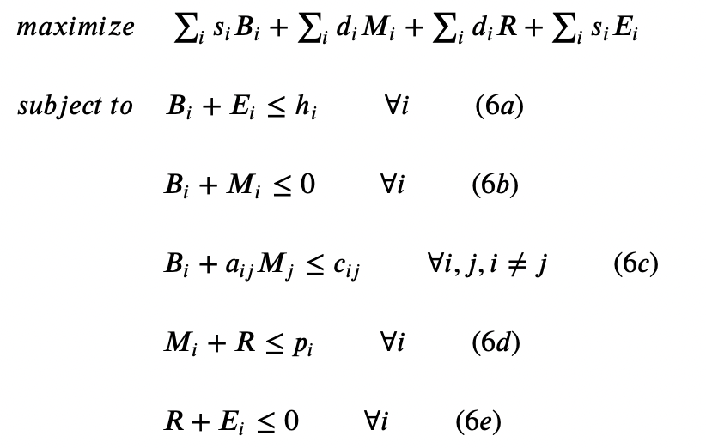
Lost Package
aij： result of transshipment from retailer i to j.
If the transshipment from i to j is successful, aij=1;
If the transshipment from i to j is unsuccessful, aij =0.
The constraints of primal problem:
Dual problem:

Slide 24
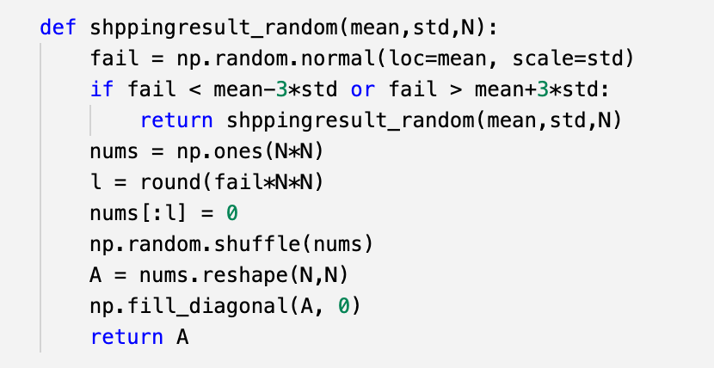
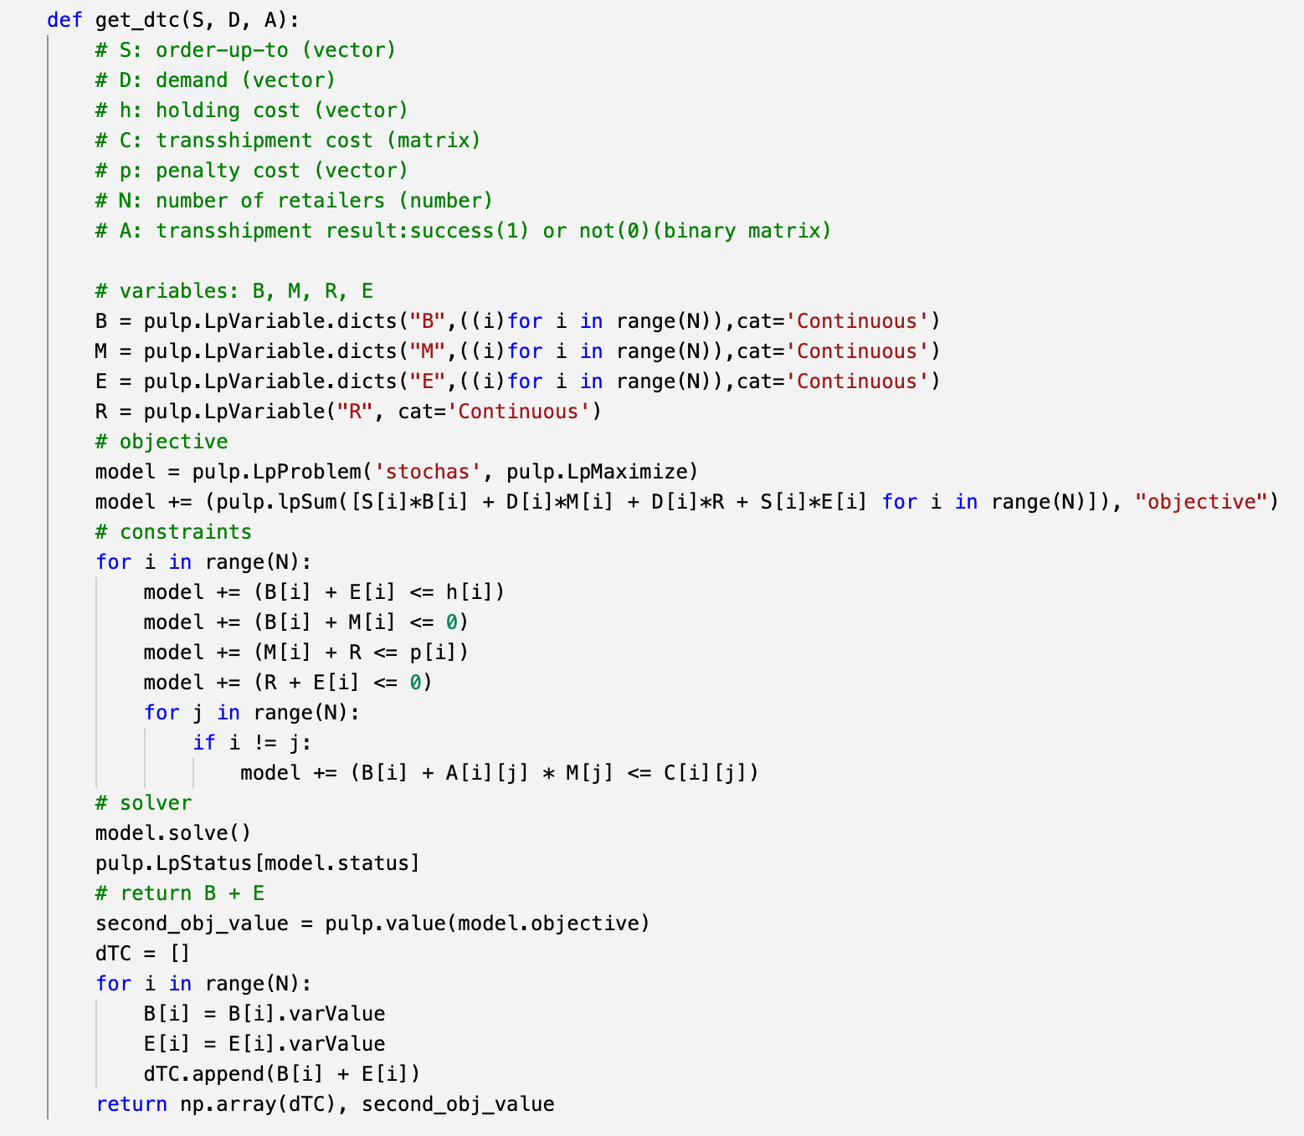
Lost Package
Input: a mean unsuccessfully delivered rate, standard deviation, and number of retailers;
Output: A (result of shipment)

Slide 25
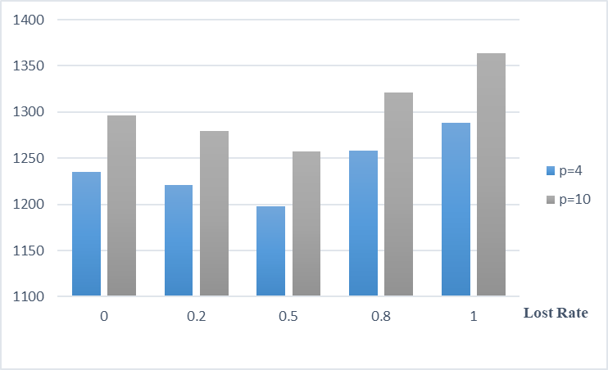
Lost Package
p=4 | 0 | 0.2 | 0.5 | 0.8 | 1
S1 | 111.79 | 109.92 | 108.04 | 103.69 | 105.11
S2 | 214.65 | 212.95 | 207.71 | 227.43 | 220.44
S3 | 163.19 | 161.34 | 155.5 | 164.78 | 165.71
S4 | 184.46 | 182.05 | 176.66 | 192.34 | 192.32
S5 | 193.88 | 191.19 | 185.96 | 179 | 202.67
S6 | 183.09 | 181.92 | 180.74 | 205.08 | 189.91
S7 | 184.37 | 181.75 | 183.46 | 185.61 | 212.02
In situation of each lost rate,
S will be greater as the lost penalty goes higher.
p=10 | 0 | 0.2 | 0.5 | 0.8 | 1
S1 | 119.99 | 118.06 | 114.67 | 123.58 | 111.84
S2 | 223.76 | 221.02 | 214.38 | 240.17 | 226.81
S3 | 171.32 | 168.98 | 164.21 | 174.46 | 172.43
S4 | 193.52 | 191.2 | 185.26 | 195.29 | 204.01
S5 | 202.7 | 200.36 | 196.17 | 202.61 | 211.75
S6 | 191.38 | 188.98 | 188.96 | 189.7 | 198.5
S7 | 193.48 | 191.02 | 193.34 | 195.55 | 238.57
p=10 | 0 | 0.2 | 0.5 | 0.8 | 1
S1 | 119.99 | 118.06 | 114.67 | 123.58 | 111.84
S2 | 223.76 | 221.02 | 214.38 | 240.17 | 226.81
S3 | 171.32 | 168.98 | 164.21 | 174.46 | 172.43
S4 | 193.52 | 191.2 | 185.26 | 195.29 | 204.01
S5 | 202.7 | 200.36 | 196.17 | 202.61 | 211.75
S6 | 191.38 | 188.98 | 188.96 | 189.7 | 198.5
S7 | 193.48 | 191.02 | 193.34 | 195.55 | 238.57

Slide 26
3.Creative Ideas
1
Improvements on the function
2
Improvements on the SA model
Early Stopping
SGDM

Slide 27
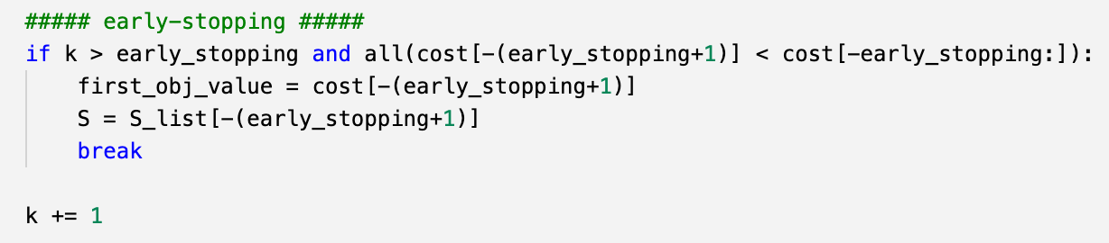
Stochastic Approximation - early-stopping and visualization
Early-stopping = 10
If the objective value doesn’t get better (total cost keeps increasing) for 10 consecutive iterations, we stop the iteration and return the n-11 result.
It’s good for decreasing the running time.
Because we need to track the objective value, we can visualize the change of total cost during iterations.

Slide 28
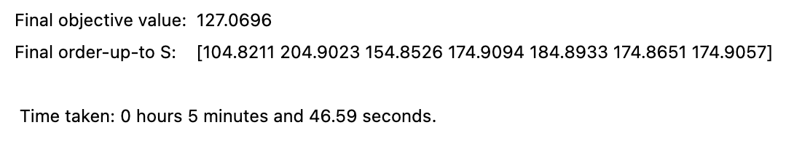
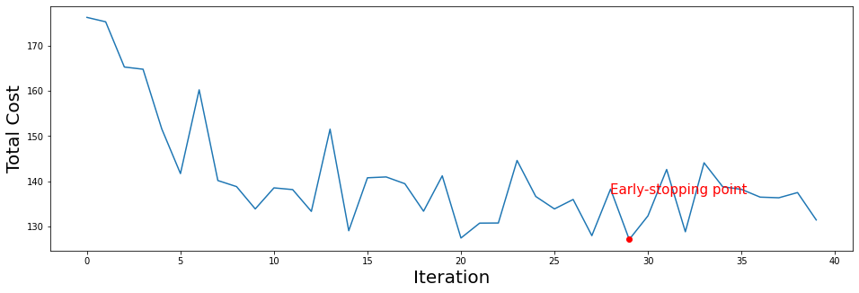
Stochastic Approximation - early-stopping and visualization
Early-stopping point

Slide 29
Stochastic Approximation - Gradient Descent with Momentum
Momentum takes into account the past gradients to smooth out the update.
The next movement depends on the gradient at this turn and the previous movement.
You can also think of it as the "velocity" of a ball rolling downhill, building up speed (and momentum) according to the direction of the gradient.
Therefore, the converge process is faster.

Slide 30
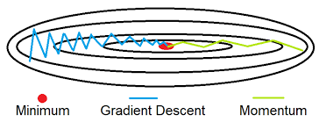
Stochastic Approximation - Gradient Descent with Momentum
Faster converge：
Balance the less useful direction
Accumulate the important direction

Slide 31
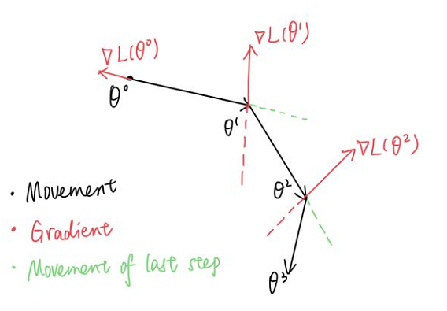
Stochastic Approximation --- Gradient Descent with Momentum
1. GD:
S = S - step_wise * subgradient
2. GD with momentum:
V = beta * V + (1-beta) * subradient
S = S - step_wise * V

Slide 32
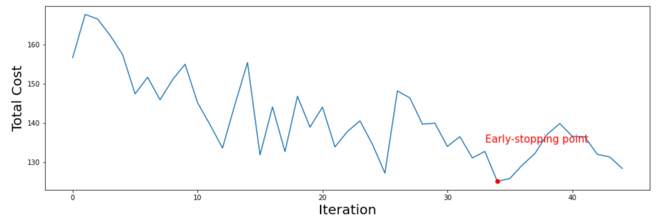
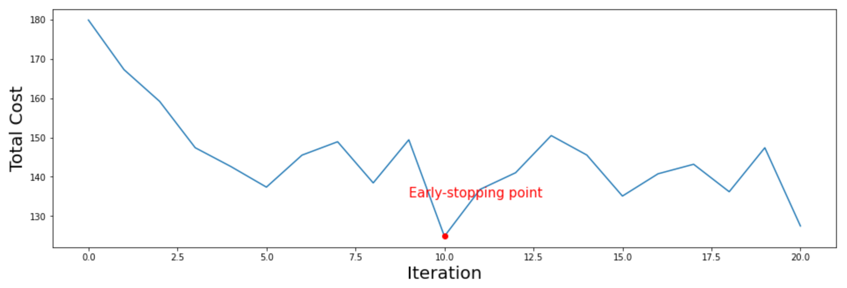
Stochastic Approximation - Gradient Descent with Momentum
beta=0.5
beta=0.2

Slide 33
Stochastic Approximation - Compare (S0 as mean)
Parameters: K=200, U=500, size_c=1 (step_wise=size_c/k)
 | Iteration | Order-up-to S | Cost | Running time
Original | 200 | [106.2864 206.4097 156.3451 176.441 186.4037 176.3483 176.4172] | 133.2376 | 31 minutes
Early-stopping | 38 | [104.8211 204.9023 154.8526 174.9094 184.8933 174.8651 174.9057] | 127.0696 | 6 minutes
Early-stopping with Momentum (beta=0.2) | 20 | [103.5913 203.6266 153.6225 173.6311 183.6296 173.6293 173.6311] | 124.8491 | 3 minutes
Early-stopping with Momentum (beta=0.5) | 44 | [104.8179 204.8678 154.8575 174.88 184.8891 174.864 174.8886] | 125.0205 | 7 minutes

Slide 34
4
Further Attempts
“Dynamic System”
Adam

Slide 35
“Dynamic System”
Penalty / Backorder Cost:
A constant value of 4
The demands of stores follow normal distributions with different μ and σ.
Holding Cost:
A constant value of 1
Transshipment Cost:
A constant value of 0.5

Slide 36

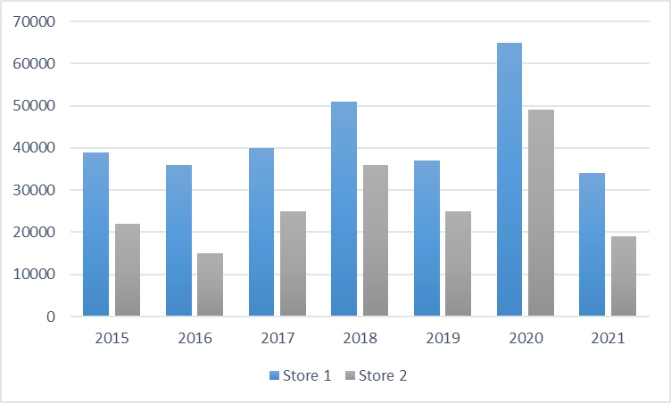
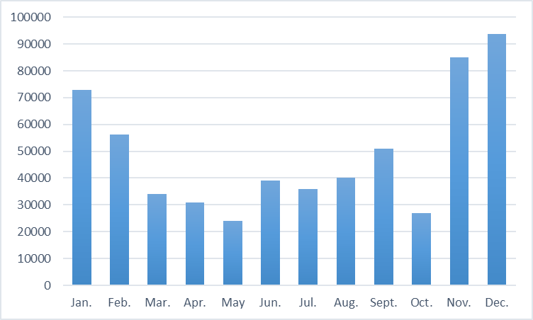

“Dynamic System”--- Demand
v.s.
May v.s Dec.
Store 1 v.s. Store 2
Time (Month, Holiday)
Location
Marketing Capacity

Slide 37
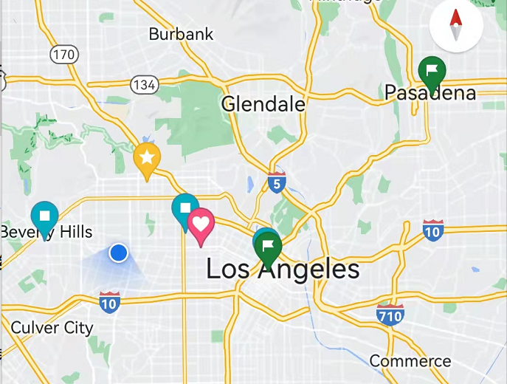


“Dynamic System”--- Transshipment Cost
v.s.
Transportation Type
Distance

Slide 38


“Dynamic System”--- Lost
Transshipment Lost

Slide 39



Adam
Adam
SGDM
RMSProp

Slide 40


Contributions & Timeline:
All-in-One | Stochastic Approximation | Stochastic Decomposition | Creative Ideas | Report
Qianran Ma & Yanan Zhou: Original Algorithm Code Optimization with different P | Wanning Li: Stage 2 Code Early Stopping SMGD | Qianran Ma & Yanan Zhou: Set up the model Solve by twoSD Solver | All | All
 | Yuxuan Cheng: Stage 1 Code Lost Package
Finish solving original models
More Creative Ideas
Finish All Creative Ideas
Portfolio!!!
2/25
3/3
3/6
3/20
4/1
5/6
Model Study
Initial Creative Ideas
Finish Some of Creative Ideas:
Early stopping
SGDM
Lost packages
Drafted Report

Slide 41
References:
Herer, Yale & Tzur, Michal & Ucesan, Enver. (2006). The multi-location transshipment problem. IIE Transactions. 38. 185-200.
10.1080/07408170500434539.
Higle, Julia & Sen, Suvrajeet. (1994). Finite master programs in regularized stochastic decomposition. Math. Program.. 67. 143-168.
10.1007/BF01582219.
Ruder, Sebastian. (2016). An overview of gradient descent optimization algorithms.
Sutskever, I. & Martens, J. & Dahl, G. & Hinton, G.. (2013). On the importance of initialization and momentum in deep learning. 30th
International Conference on Machine Learning, ICML 2013. 1139-1147.
Warren B. Powell. 2007. Approximate Dynamic Programming: Solving the Curses of Dimensionality (Wiley Series in Probability and
Statistics). Wiley-Interscience, USA.
Yao, Yuan & Rosasco, Lorenzo & Caponnetto, Andrea. (2007). On Early Stopping in Gradient Descent Learning. Constructive
Approximation. 26. 289-315. 10.1007/s00365-006-0663-2.
Zhao, Lei & Sen, Suvrajeet. (2006). A Comparison of Sample-Path-Based Simulation-Optimization and Stochastic Decomposition for
Multi-Location Transshipment Problems. Proceedings - Winter Simulation Conference. 238-245. 10.1145/1218112.1218161.

Slide 42

Thanks for your attention
Fight on
Group 6:
Qianran Ma (7798937244) Presenter
Wanning Li (5898212888)
Yanan Zhou (4366462176)
Yuxuan Cheng (1278632602)
March 10, 2022

